Slide 1
C300 Final Evaluation
Team ID:
SOI-2020-0070
Team Members:
1.Timorthy
2.Liang Kok
3.Hong Jun
4.Zhi Hao
Project ID:
SOI-2020-2010-0026
Project Title:
RADIUS Implementation

Slide 2
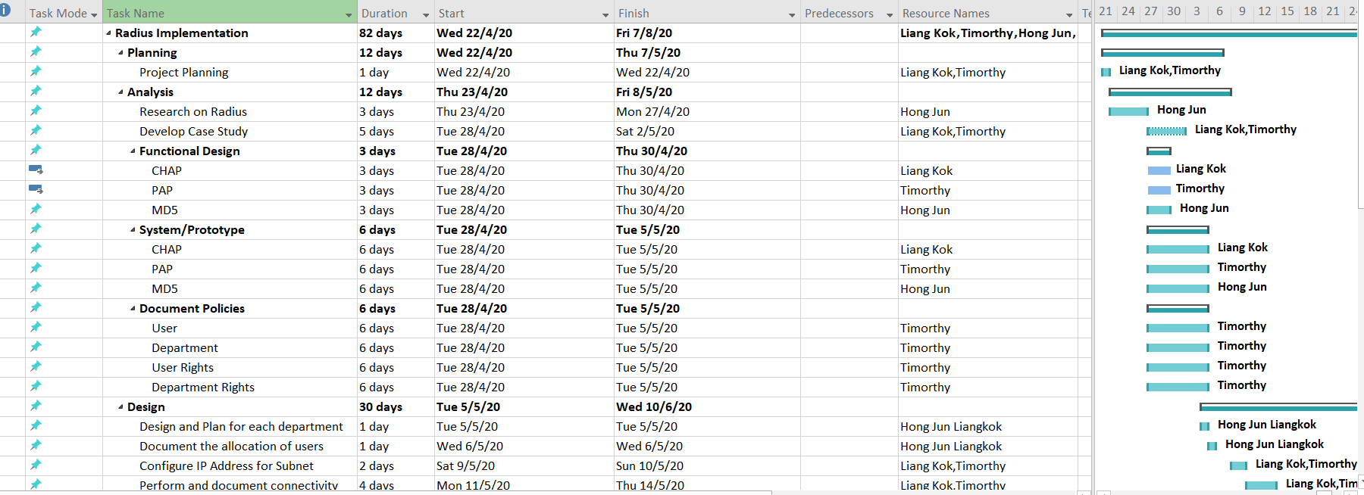
Gantt Chart

Slide 3
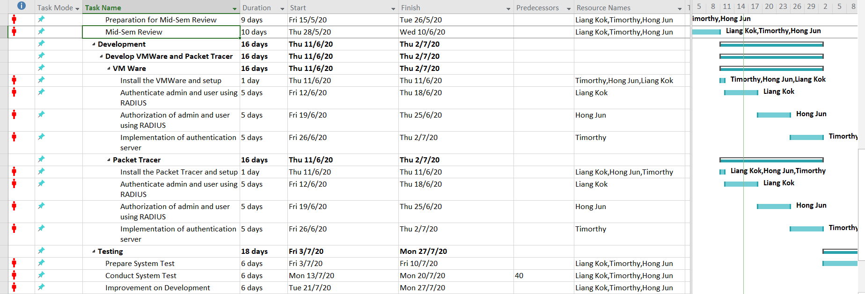
Gantt Chart

Slide 4
Introduction
What is our project about?
To create authentication service with Radius server for a small corporate company. Different staff of different department to gain authorization and authentication through different type of Networking Authentication Protocols. (EAP,PAP,CHAP,MD5 etc.)

Slide 5
Project Specification
Authentication of admin & user using RADIUS authentication methods
Authorization of admin & user using RADIUS service
Demonstrate the implementation of the authentication server on VM
Skill set required:
Knowledge of C225, C226, C327, C328
Resource required:
Packet tracer, VMware, 2 laptops

Slide 6
Reason of using Radius Server
Using Windows Radius Server as Windows Server Editions and NPS(Network Policy Server)
NPS provides different functionality depending on the edition of Windows Server that you install.
Windows Server 2016 or Windows Server 2019 Standard/Datacenter Edition
With NPS in Windows Server 2016 Standard or Datacenter, you can configure an unlimited number of RADIUS clients and remote RADIUS server groups. In addition, you can configure RADIUS clients by specifying an IP address range.

Slide 7
Radius Server
What is RADIUS?
RADIUS stands for Remote Authentication Dial-In User Service
It is a networking protocol operating on port 1812
Provides centralized Authentication, Authorization and Accounting (AAA) management for users who connect and use a network service
RADIUS is a client/server protocol that runs in application layer
Uses either TCP or UDP as transport

Slide 8
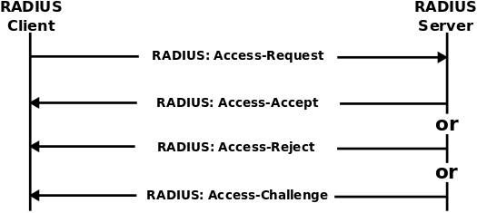
Radius Server
Authentication and Authorization
User or machine sends a request to a Network Access Server (NAS)
To gain access to a particular network resource using access credentials
The credentials are then passed to the NAS device via the link-layer protocol
After that, NAS sends a RADIUS Access Request message to the RADIUS server
Requesting authorization to grant access via the RADIUS protocol
The request will include access credentials, typically in the form of username and password or security certificate provided by the user
The request may contain other information which the NAS knows about the user, such as its network address or phone number, and information on the user’s physical point of attachment to the NAS
The RADIUS server checks that the information is correct using authentication schemes such as PAP, CHAP, EAP

Slide 9
Point to Point Protocol (PPP)
Default RAS protocol in window
Data link-layer protocol used to encapsulate higher network-layer protocols to pass over synchronous and asynchronous communication lines.
Microsoft use Three Main Protocol for PPP
The Internet Protocol Control Protocol (IPCP)
The Internet Packet Exchange Control Protocol (IPXCP)
The NetBIOS Frame Control Protocol (NBDCP)

Slide 10
Point to Point Protocol (PPP)
PPP uses three components together to enable it to communicate.
High-Level Data-Link Control (HDLC)
Link Control Protocol (LCP)
Network Control Protocols (NCPs)
To authenticate, the client creates an initial connection via LCP. The server then begins the protocols (Etc. PAP,CHAP) authentication process

Slide 11
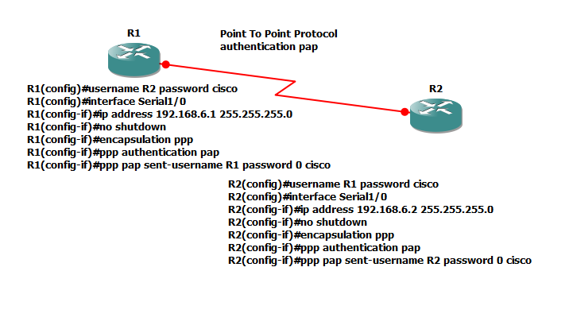
PAP Protocol
PAP: Password Authentication Protocol (PAP) is a password-based authentication protocol used by Point to Point Protocol (PPP) to validate users. Almost all network operating system remote servers support PAP.
The password is sent in clear text.
All network operating systems support PAP.
It uses two-way Handshake Protocol.
It is non-interactive.
PAP supports both one-way authentication (unidirectional) and two-way
authentication (bidirectional).
Collect usernames and other data that is needed for authentication.
Ensure that all potential callers are in the server's password database.
Create security credentials for all prospective callers in /etc/ppp/pap-secrets.
Add options specific to PAP to the /etc/ppp/options and /etc/ppp/peers/peer-name files.

Slide 12
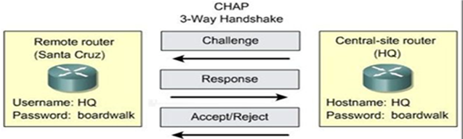
CHAP Protocol
Challenge-Handshake Authentication Protocol (CHAP)
- Encrypted challenge sent over the network
- Authentication scheme used by Point-to-Point Protocol (PPP) servers to validate the identity of remote clients.
Three-way handshake
- After link is established, server sends a challenge message
- Client responds with a password hash calculated from the challenge and password
- Server compares received hash with stored hash
Challenge-response continues
- Occurs periodically during the connection
- Users never know it happens

Slide 13
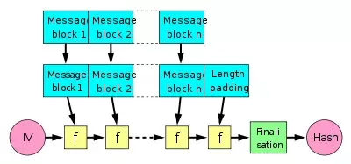
MD5 Protocol
Message Digest algorithm 5 (MD5)
-It is a hash function producing a 128-bit hash value
-Can be use as a checksum for verifying data
The MD5 message digest hashing algorithm processes data in 512-bit blocks, broken down into 16 words composed of 32 bits each. The output from MD5 is a 128-bit message digest value.
Computation of the MD5 digest value is performed in separate stages that process each 512-bit block of data along with the value computed in the preceding stage:
-The first stage begins with the message digest values initialized using consecutive hexadecimal numerical values
-Each stage includes four message digest passes which manipulate values in the current data block and values processed from the previous block
-The final value computed from the last block becomes the MD5 digest for that block

Slide 14
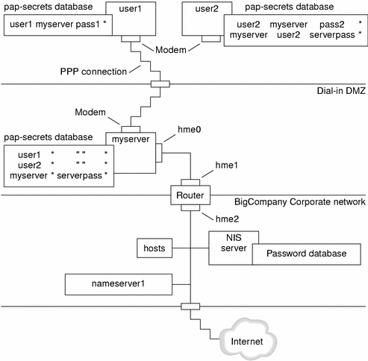
System Design (PAP Prototype)

Slide 15
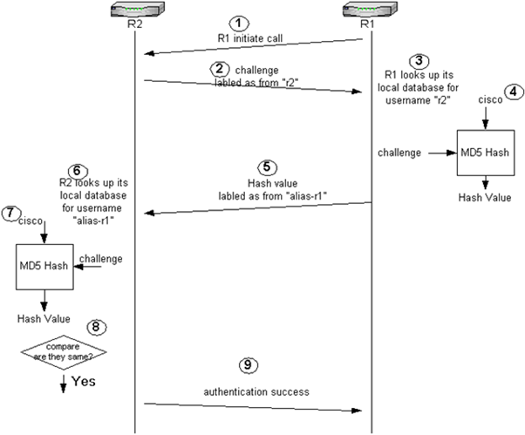
System Design (CHAP Prototype)

Slide 16
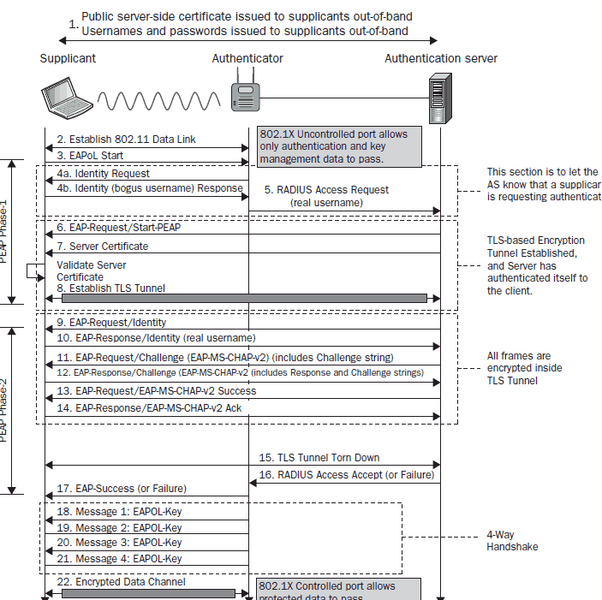
System Design (MD5)

Slide 17
Document Policies
Common Group Policy to be set on all departments
Prohibit access to Control Panel and PC settings
Prevent access to the command prompt
No auto-restart with logged on users for scheduled automatic updates installations
All removable storage classes: Deny all accesses
Prohibit User Install
Guest Account status: Disabled
Minimum password length: 8
Maximum password age: 180 days

Slide 18
Consolidated research
PPP Method: CHAP
CHAP is more secure than PAP
CHAP provides authentication periodically to verified the user
MD5 is part of CHAPv2 which only encrypt the password to hash

Slide 19
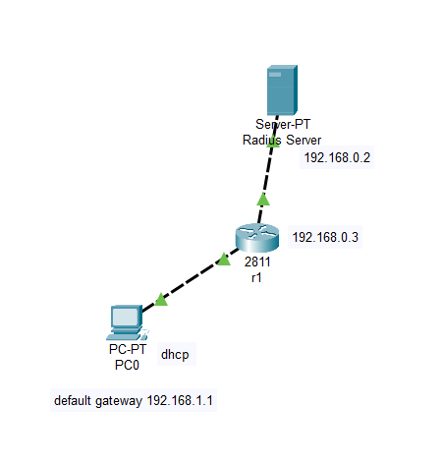
Overview of the system design

Slide 20
End Deliverable
VMware
Radius authorization
Radius server
DHCP
Packet tracer
Radius authentication
Radius authorization
DHCP

Slide 21
Prototype Walk Through / Demonstration
-Packet Tracer
- VMware

Slide 22
Team’s Achievement
Productive teamwork
Constructive discussion
Initiative to take lead
Positive attitude

Slide 23
Learning Points
How to use:
Packet tracer
VMware Workstation
Knowledge:
Radius Server
Router configuration
Active Directory
DHCP
Teamwork is Key
Never Give Up

Slide 24
Experience and Reflection of the team
It is a worthwhile experience to get the chance to develop a Radius Implementation
We should put more time in the Development and Testing process instead of the Research process
It’s been hard to communicate during the covid 19 period

Slide 25
Task Allocation and Progress
Timorthy
Task | Progress
Research | 100%
Planning of Policies | 100%
Design of Network | 100%
Authentication Server VM | 85%
FYP Report | 85%
User Guide | 50%
Note: Indicate past, current and future task

Slide 26
Task Allocation and Progress
Liang Kok
Task | Progress
Research | 100%
Planning of Policies | 100%
Design of Network | 100%
Authentication Server VM | 85%
FYP Report | 85%
User Guide | 50%
Note: Indicate past, current and future task

Slide 27
Task Allocation and Progress
Hong Jun
Task | Progress
Research | 100%
Planning of Policies | 100%
Design of Network | 50%
Authentication Server VM | 50%
FYP Report | 0%
User Guide | 0%
Note: Indicate past, current and future task

Slide 28
Task Allocation and Progress
Zhi Hao
Task | Progress
Research | 10%
Planning of Policies | 0%
Design of Network Address | 0%
Authentication Server VM | 0%
FYP Report | 0%
User Guide | 0%
Note: Indicate past, current and future task

Slide 29
Records of Team Meetings with Supervisor
Name | 22 April | 29 April | 6 May | 13 May | 20 May | 26 May
Timorthy | Present | Absent | Present | Present | Present | Present
Hong Jun | Present | Present | Present | Present | Present | Present
Liang Kok | Present | Present | Present | Present | Present | Present
Zhi Hao | Present | Present | Absent | Absent | Absent | Absent
Note: Insert new column as required

